Slide 1
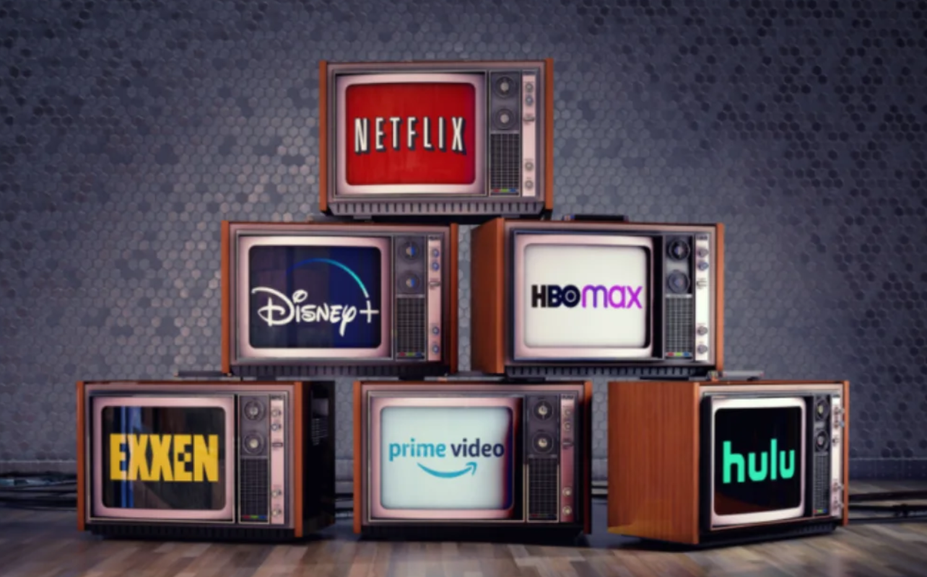
Streaming Platform Strategy Analysis
A Data-Driven Analysis of Netflix's Content Strategy
Thrisha Jawahar

Slide 2

The Streaming Industry Operates in a Content-Driven, Hyper-Competitive Landscape
Content as Differentiator
Platforms compete using content volume, variety, and quality as key differentiators
Original Content Focus
Increasing focus on original and recent content to drive subscriber acquisition
User Expectations
Users expect both diversity and high-quality premium experience across devices
Continuous Differentiation
Competition drives continuous differentiation strategies and content innovation
Strategic Context
Market characterized by high customer acquisition costs and retention pressure

Slide 3
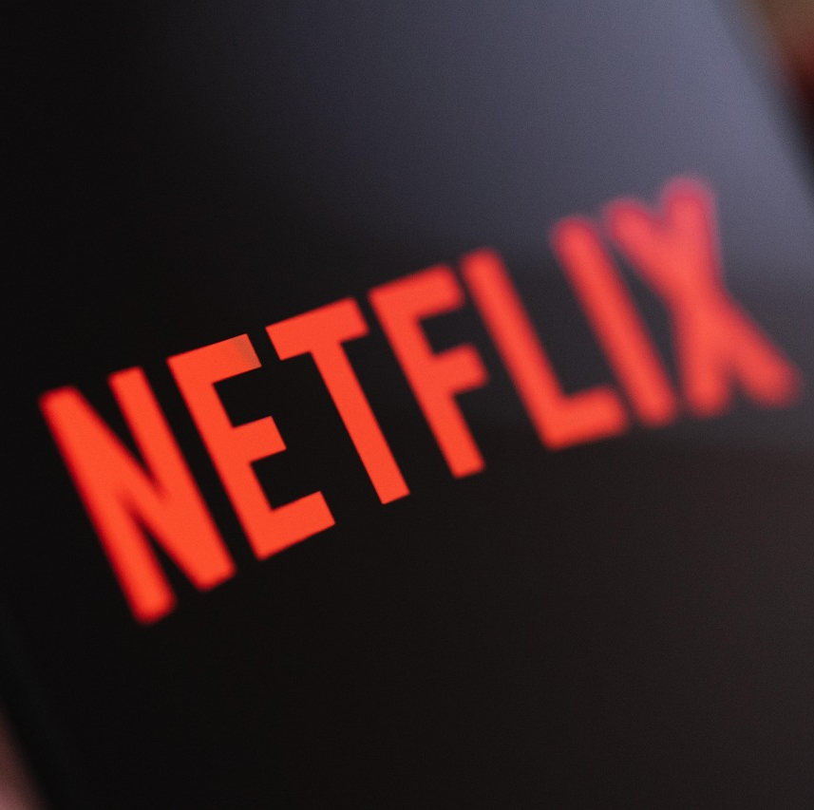
Platform Analysis: Netflix
Netflix operates a high-volume global strategy.
277M subscribers globally (2024)
Large and diverse content catalog
Movie-heavy platform compared to TV
Global presence across multiple regions
Key Takeaway: Netflix prioritizes scale and reach to dominate the market

Slide 4
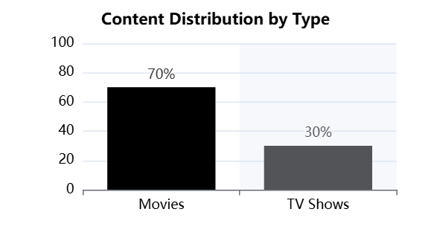
Key Insight 1
One of the largest content libraries
Covers multiple genres and audience segments
Ensures constant content availability
Takeaway: High volume drives engagement and audience reach

Slide 5
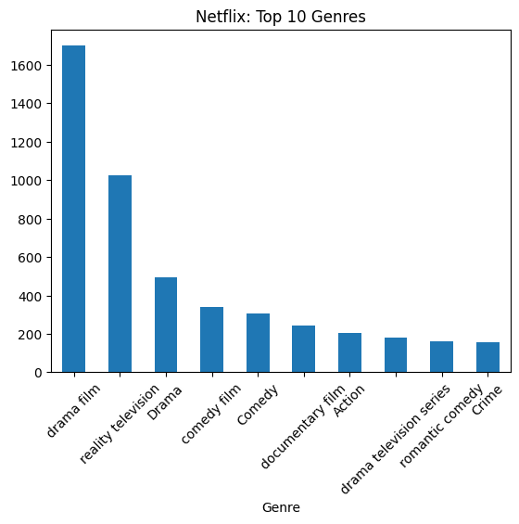
Key Insight 2
Content is concentrated in mainstream genres.
Top Dramas:
Drama
Comedy
Reality
Limited representation of niche genres.
Overlap with competitor content strategy.
Takeaway: Netflix focuses on mass appeal rather than niche differentiation.

Slide 6
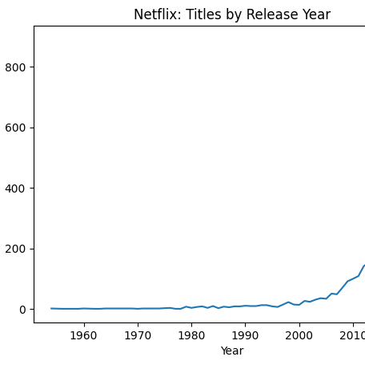
Key Insight 3
Netflix emphasizes modern content.
Majority of titles released after 2015
Continuous addition of new content
Strong focus on recent releases
Takeaway: Modern content increases relevance and retention.

Slide 7
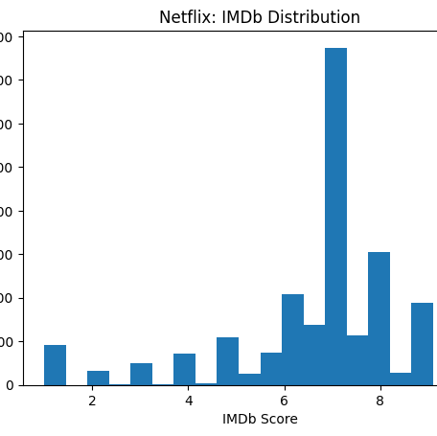
Key Insight 4
Content quality is consistent but varies.
Ratings mostly between 6-7
Presence of lower rated content
High volume leads to variability
Takeaway: Scale leads to inconsistent quality perception.

Slide 8
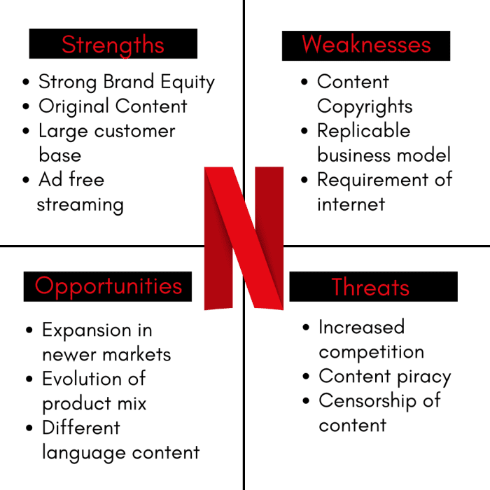
SWOT Summary
Netflix shows strong scale but quality risks.
Strengths: Netflix has a large, diverse catalog with mostly modern content and steady mid-to-high quality ratings.
Weaknesses: It focuses heavily on volume, which may reduce exclusivity and premium perception.
Opportunities: Netflix can invest more in high-rated prestige content and expand successful genres globally.
Threats: Strong competition and rising production costs could challenge its growth and differentiation.

Slide 9
Strategic Recommendation
Recommendation | Metric Impact
Niche content | Increase subscribers
Better recommendations | Increase retention
High-quality content | Increase engagement
Shift from high volume to high impact content.
Invest in niche and international content
Increase focus on high-quality productions
Improve recommendation system
Takeaway: Balance quantity with quality.

Slide 10
Impact Logic Mapping
Strategy: Invest in niche and international content.
More diverse and localized content ↓ Attract new audience segments globally ↓ Increase total subscribers ↓ Expand user base ↓ Higher revenue
Takeaway: Content diversification directly drives subscriber growth
Strategy: Improve recommendation algorithm
Better content personalization ↓ Users find relevant content faster ↓ Increased content consumption ↓ Higher user satisfaction ↓ Lower churn rate ↓ Higher retention rate
Takeaway: Personalization improves engagement and retention

Slide 11
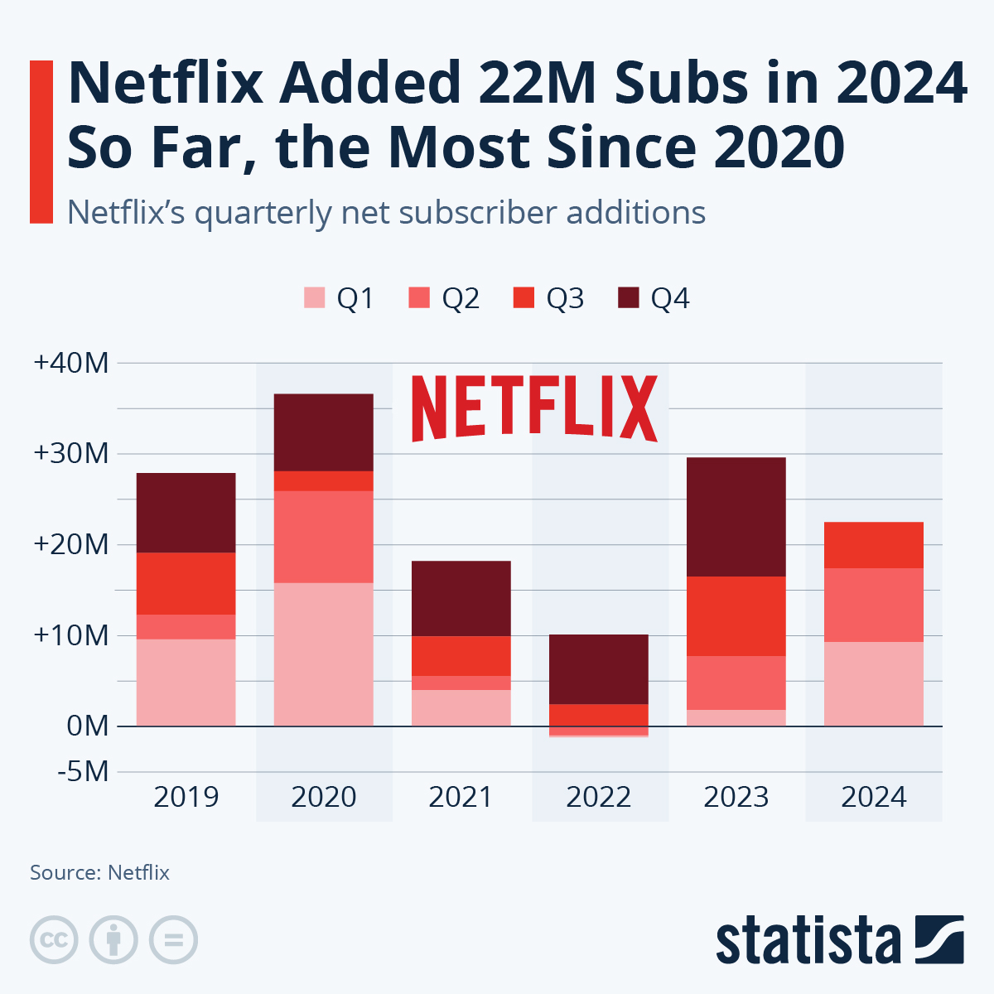
Expected Impact (Subscriber Growth)
Real Data:
Subscribers 277 Million
Source: Netflix Revenue and Usage Statistics (2026) - Business of Apps
Assumption:
5% growth
Calculation:
277M * 1.05 = 291M
+ 14M users
Revenue:
Avg revenue = $11.7/Month
Annual = $140
Impact:
14M * $140 = $1.96B increase
Takeaway: Small growth, Billions in revenue.

Slide 12
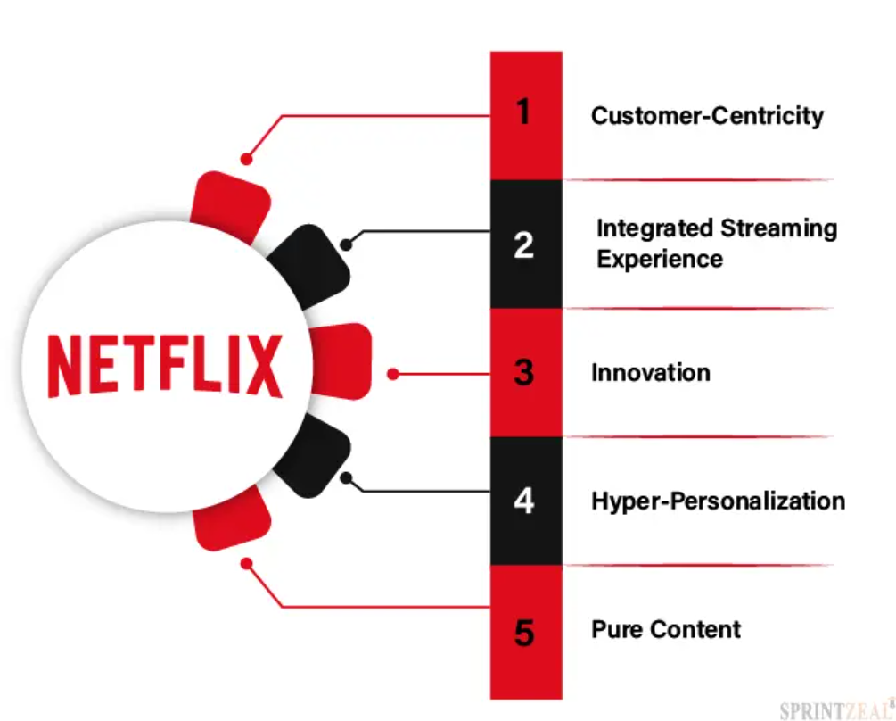
Expected Impact(Retention)
Real Data:
Subscribers: 277M
Churn: 20% = 55M Users leaving
Improved Scenario:
Retention: 80% to 85%
New Churn: 15% = 41M
Users Saved: 14M
Revenue Impact: 14M * $140 = $1.96B retained
Takeaway: Retention is a high ROI strategy

Slide 13
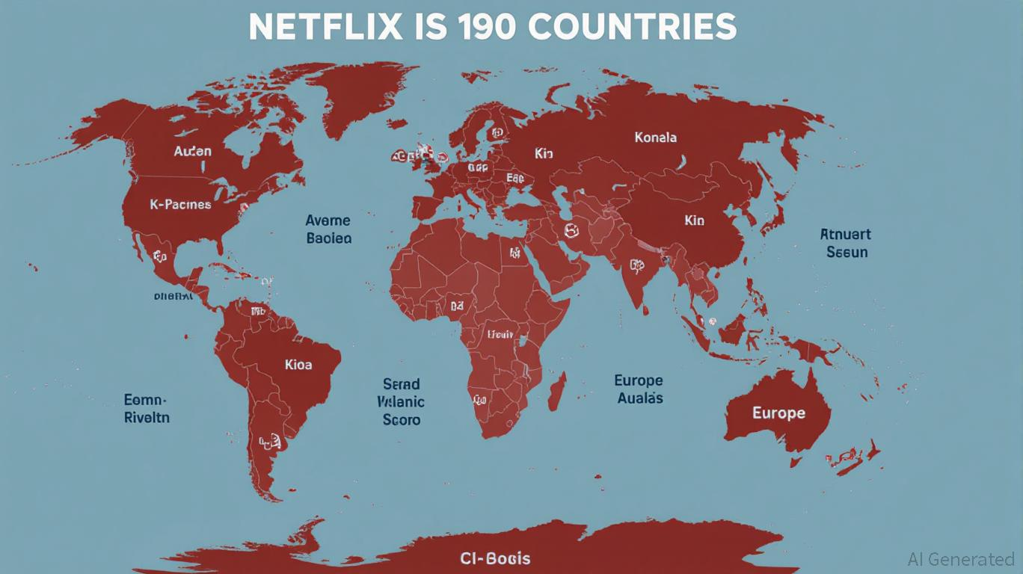
Conclusion
Netflix’s strategy is strong but needs refinement.
Strong in scale and diversity
Needs better quality and differentiation
Strategic investment can improve long term growth
Final Takeaway: Balancing volume + quality = sustainable advantage

